Slide 1
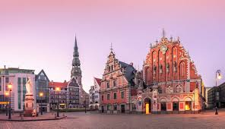
Traditions and holidays in Latvia
Fatsène Lili Carmen

Slide 2
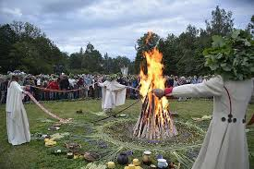
What are the most important celebration in Lativa ?
Ligo is the day of grass, it is celebrated on he eve of St.John’s Day wich is called Jani. During Ligo,Latvians gather with family and friends to share a meal.Grass is spread around the houses. On Jani day, people sing and light bonfires. These traditionals rites are made to drive away evil spirits.

Slide 3
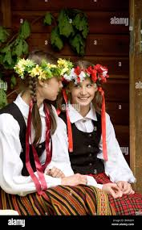
Is there traditionnal clothes, dances or music ?
Slavic dress is the traditionnal clothing it is a skat with an apron a jacket and a blouse. In Latvia, since the and of the 19th century, the city of Rigatas hostend a national festival of traditional dances and songs, on extraordinaly popular event. During this event, traditional Dainas songs are sung. Dainas are considered the rector of Lativan culture through cent of serfdom and occupation.

Slide 4
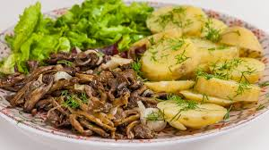
What are the culimary specialities ?
Lativian gastronomy is hased primarily on fish, both smocked and cooked. Caviar pike sardines and herring are the most common. Meat is usually served with potatoes, peas and mushrooms.

Slide 5
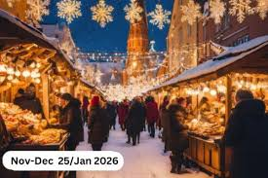
Are some traditions similar to those in France?
Yes,some traditions are celebrated in France and in Lativia like St.John’s Day with is called « St Jean » in France or even Christmas . In datvia and in France, people like to gether in family or friend share a meal together and enjoy every moments with the people they love.

Slide 6
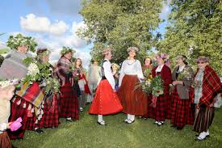
How do Latvans celebrate Christmas and summer ?
For christmas, carols are sung in homes and churches, emphasizing the spiriual and peaceful nature of the holiday season.Mumming, or masked singing and dancing, is popular during Ziemassvetki, where people dress up as different characters and visit neighbors, bringing joy and good wishes.
To celebrate summer, Lativian like to go on A barefoot strall,do a nap in the shade, sunbathing, or picnic in the tall grass…
The solstice of summer is an ideat time to honor nature and become aware of its abundant beauty.Direct contact withe the elements (earth,water,fire,air) allows us to feel connected to the living.

Slide 7
Thanks you for listenning !!!!!!
Fatsène Lili Carmen

